Slide 1
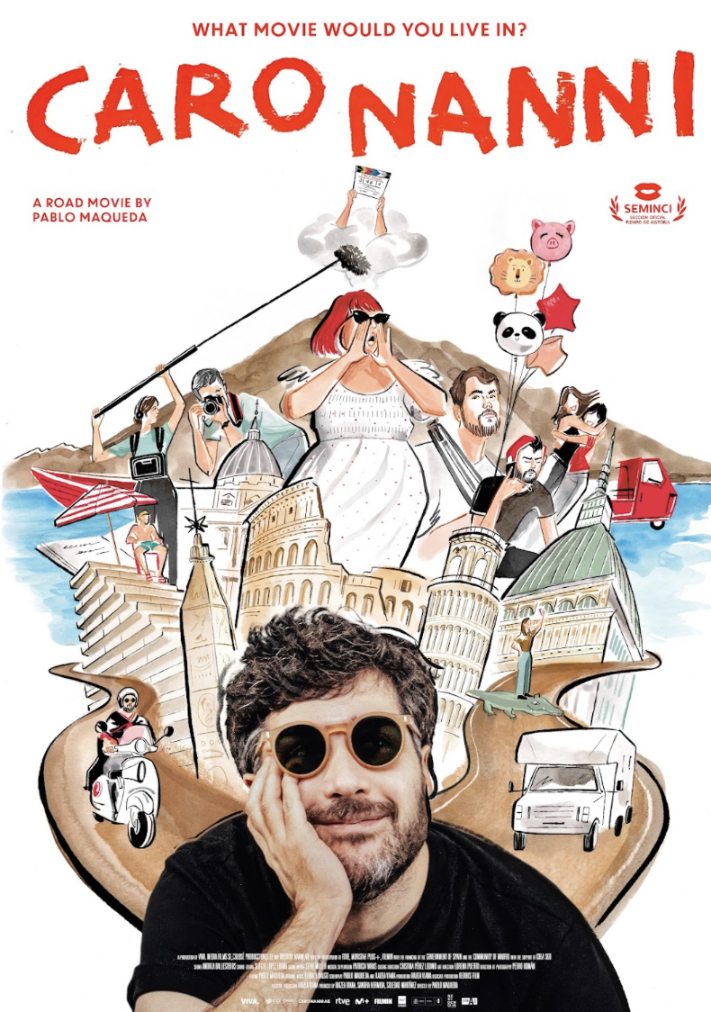

Slide 2
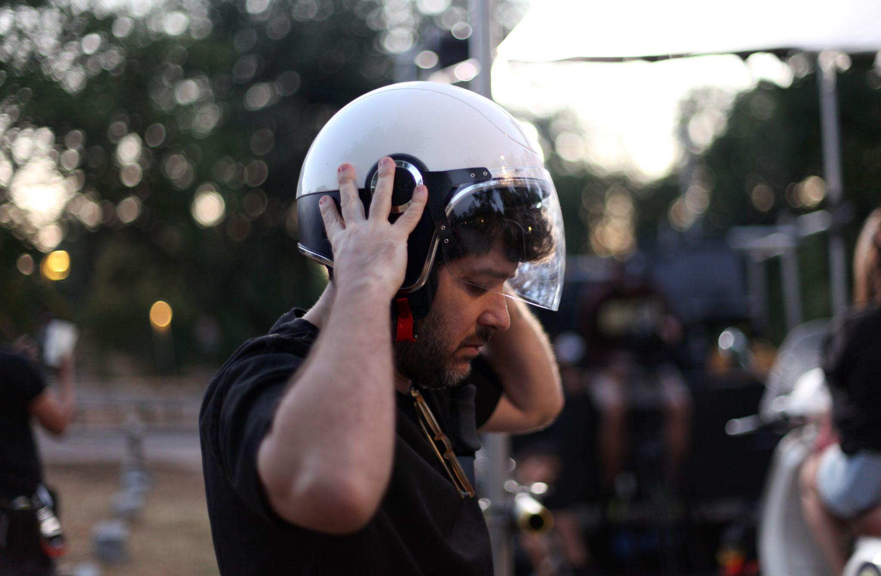
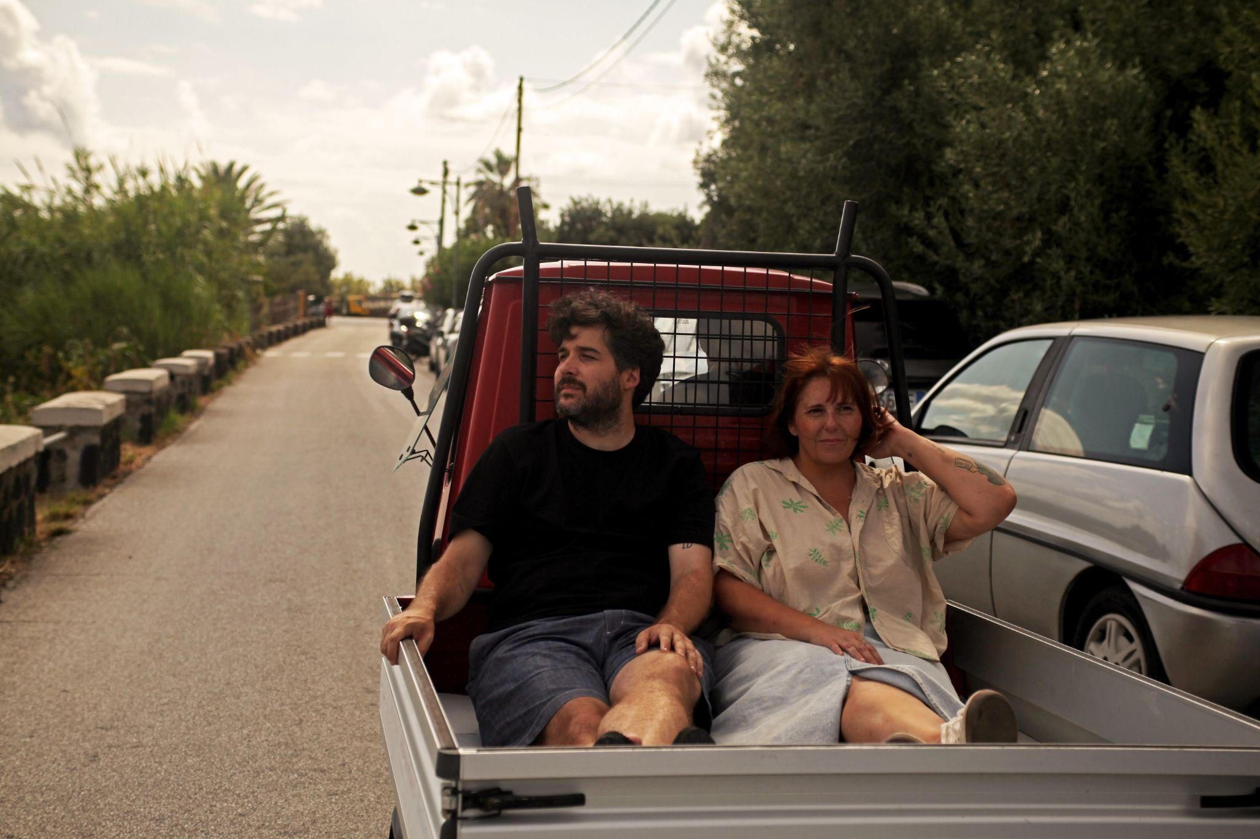


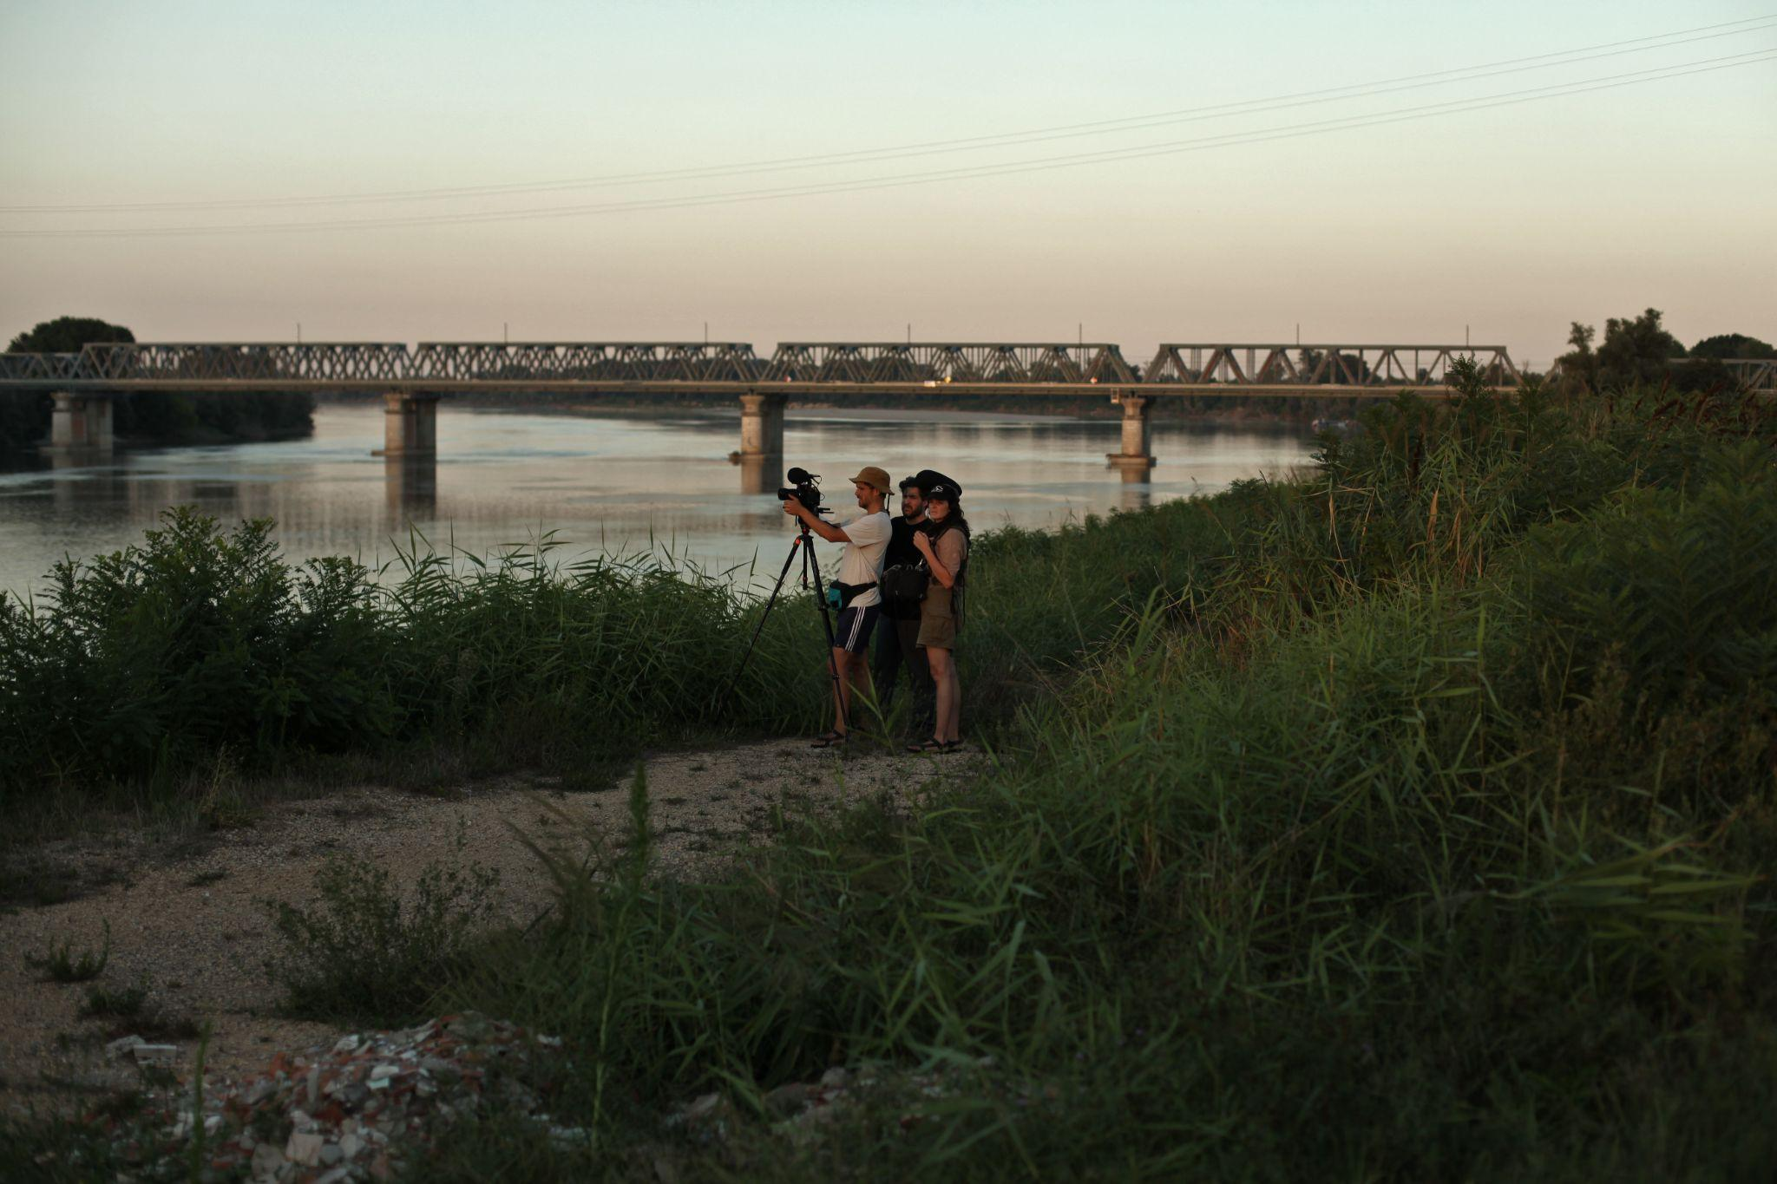
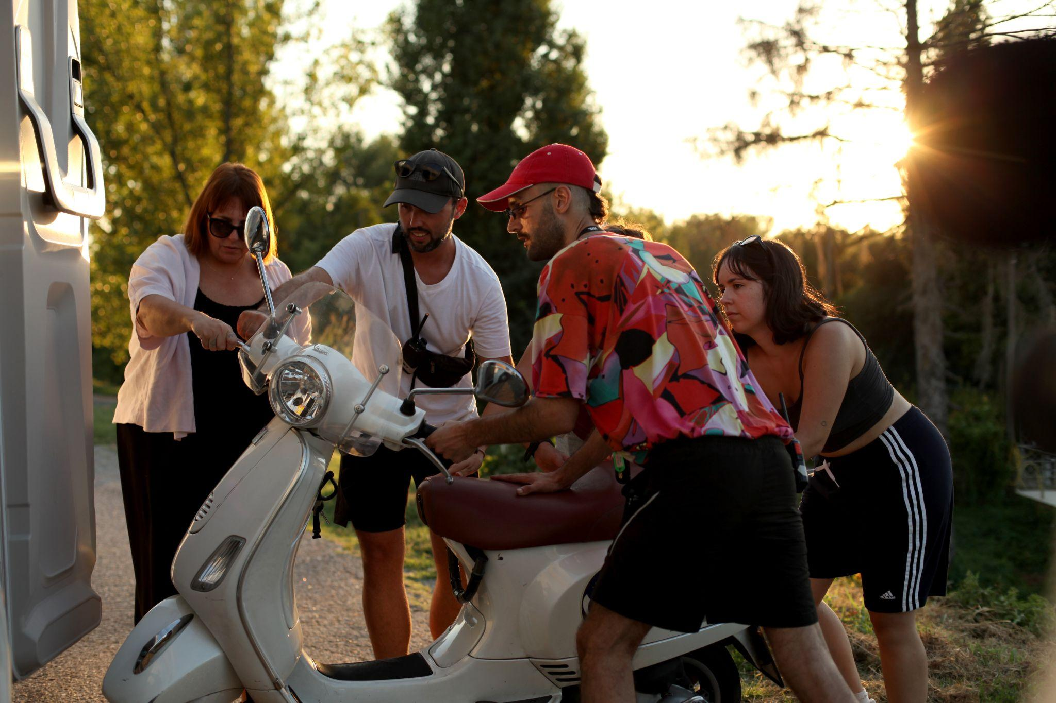
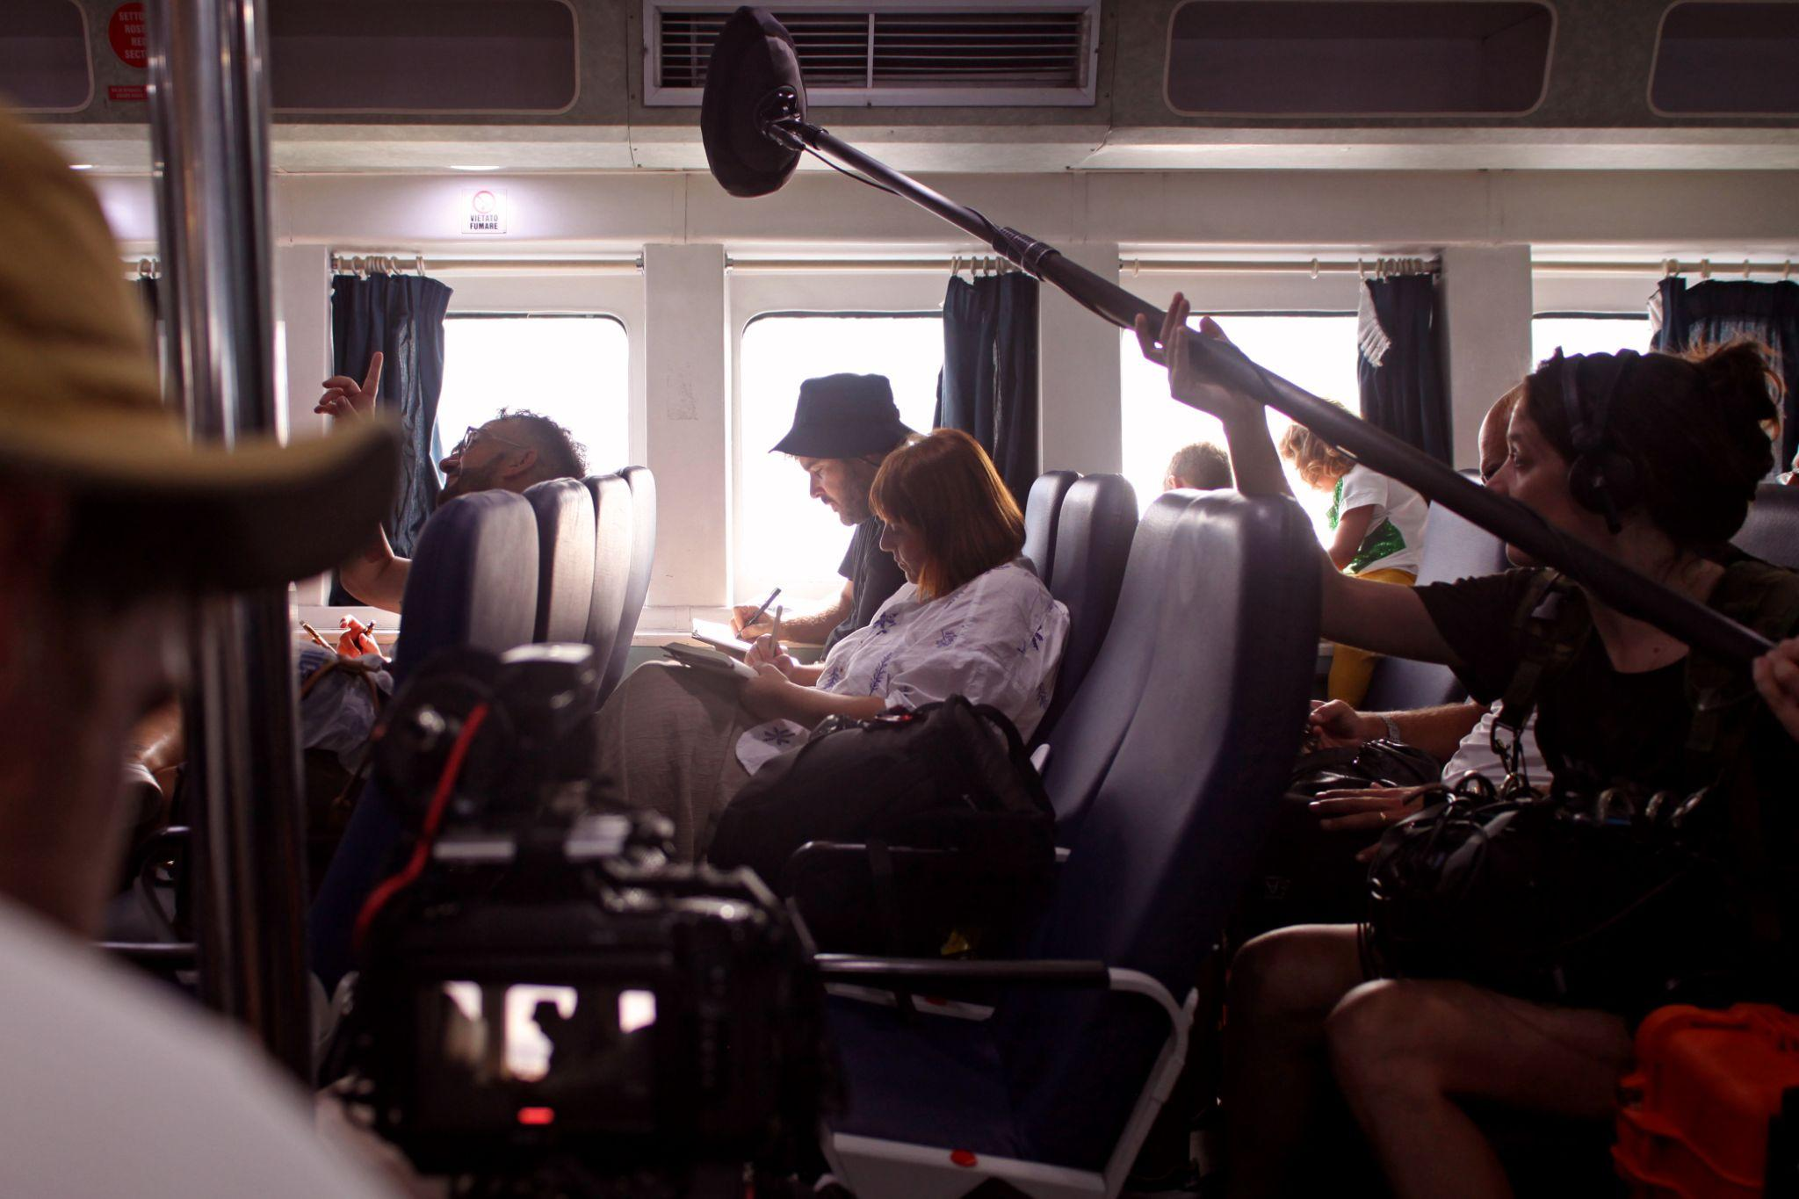
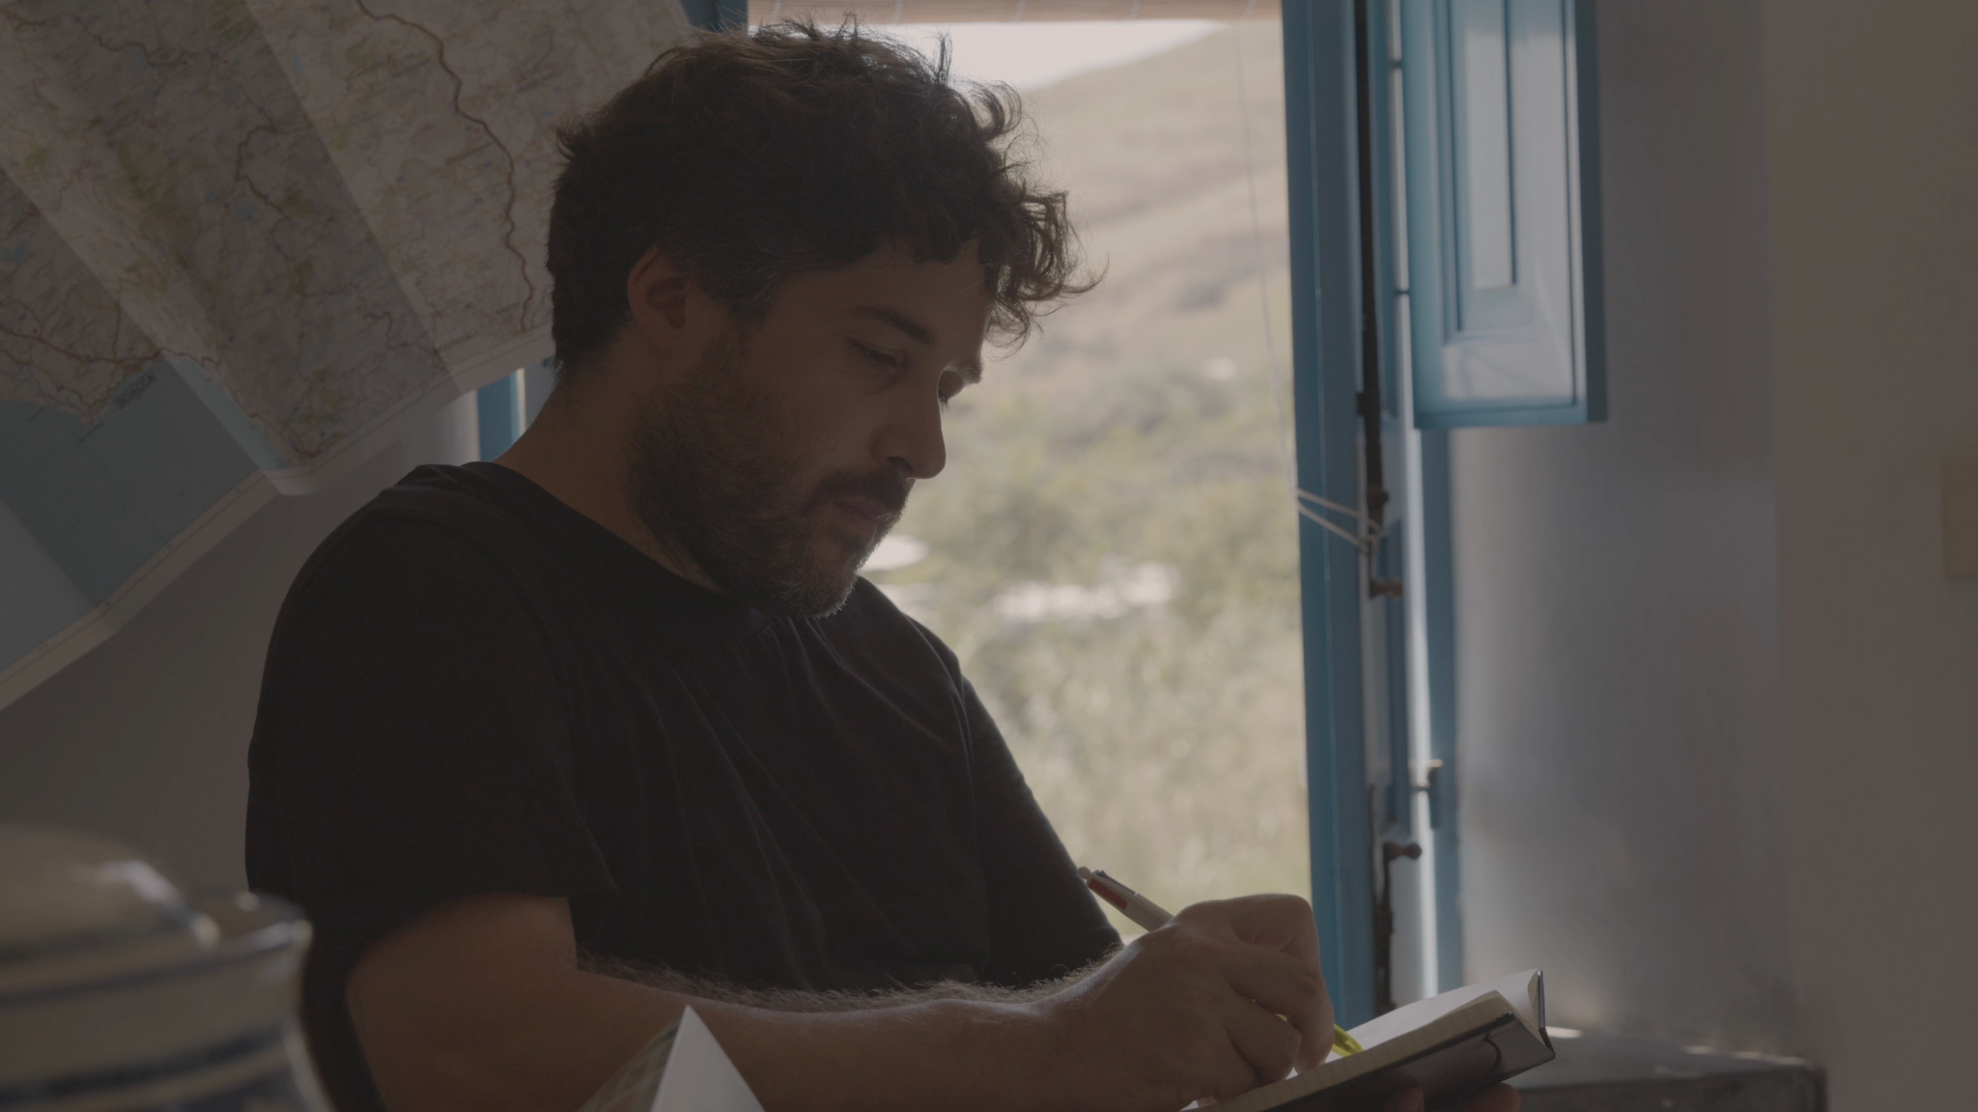
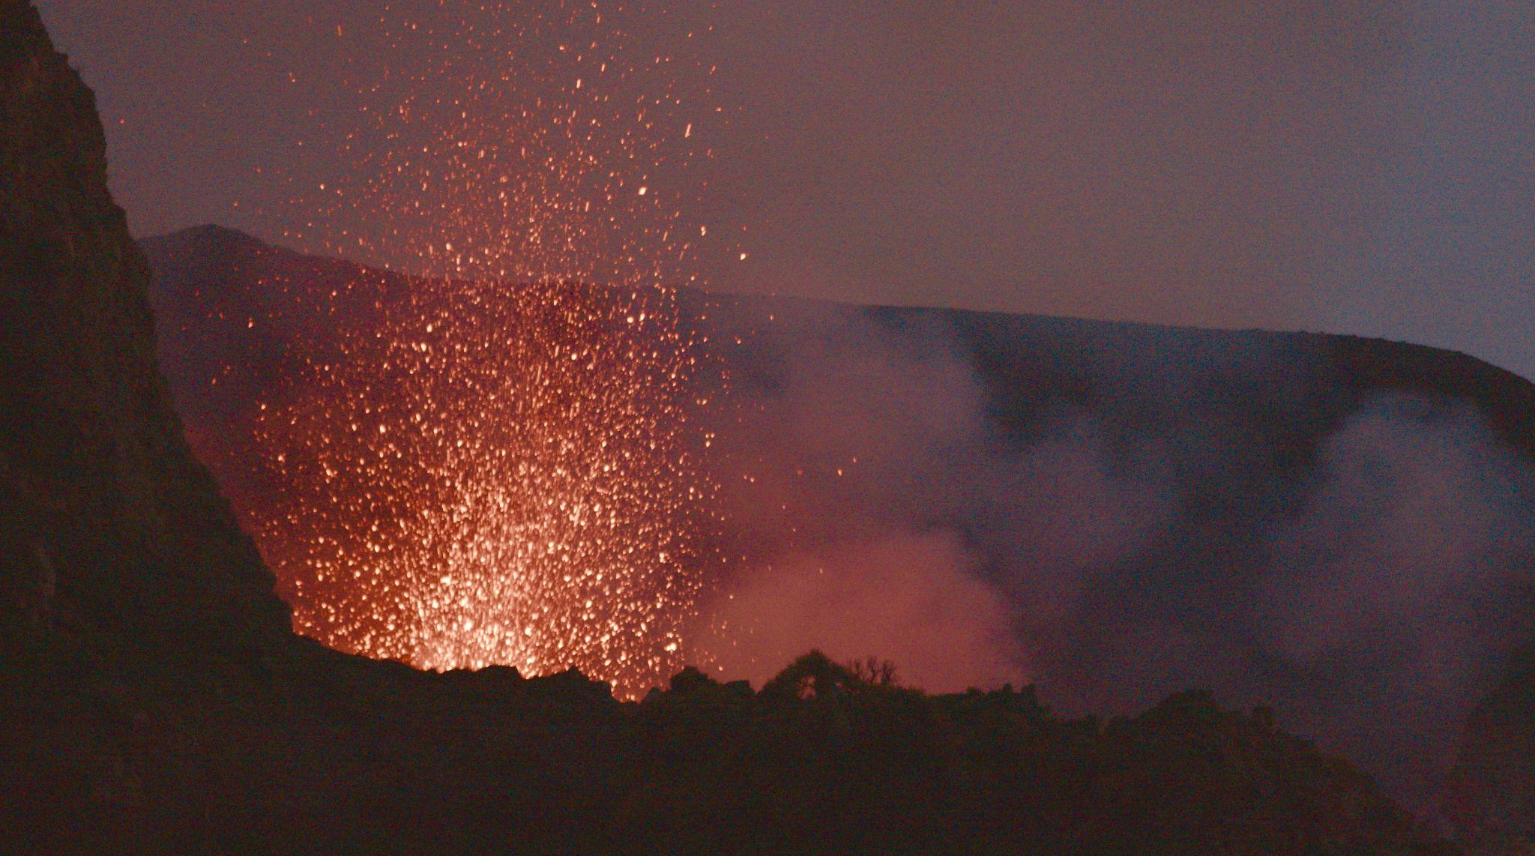

Slide 3
Cost controller
Eva Vázquez
Viva Films Media, labour and tax advisory
Silleras Asesores
Viva Films Media, legal counsel
Visual in Law
Fabien Grinvalds
Casting director
Cristina Pérez Lozano
Editing
Pablo Maqueda
Carlos Cañas Carreira
Assistant Editor
Agustín Serna G. Lavín
Assistant Director, Spain Unit
Pedro Román
Assistant Director, Italian Unit
Alberto Baldini
Production sound
Andrea Ballesteros i Beato
Sound design
Sergio López Eraña, Milciclos
Re-recording mixing
Steve Miller, Milciclos
Sound Effects editor
Sergio López Eraña, Milciclos
Dialogue editor
Anqi He
Foley
Max Miao
CAST
Pablo
Pablo Maqueda
Narrator
Eva Llorach
Pier Paolo Pasolini
Vicente León
Special Appearance by
Isabel Coixet
Margherita Buy
Rocío León
CREW
Director
Pablo Maqueda
Screenplay
Pablo Maqueda
Haizea Viana
Production
Haizea Viana
Sandra Hermida
Associate Producers
Soledad Martínez
Cristina Lera Gracia
Colosé Producciones, executive producer
Javier Soto
Colosé Producciones, finance director
Beatriz Mayo
Colosé Producciones, legal counsel
Santiago Mediano Abogados
Juan López

Slide 4
Foley editing
Alejandro Robles Morán
Studio manager
Yhannis Padilla Núñez
Sound Post-Production Studio
Milciclos
Original music
Elena Hidalgo
Original song
“Una vespa tras un sueño”
Pablo Maqueda
Paco Ortega
Recording Studio
Musigrama Studios
Director of Photography, Spain Unit
Fernando Melero
Director of Photography, Italian Unit
Pedro Román
Gaffer
Javier Lozano
Focus Puller
Irene de Anta
Still Photographer
Mario Orellana Encinar
Production design
Lorena Puerto
Props master
Lucía Mateu
Props assistant
Gloria Escribano Ruiz
Production manager
Haizea Viana
Production Assistant
Laura Martínez Santamarina
Production Assistants
Lola Rosales
Edgar Barceló
Ana Rodríguez
Production intern
Mariamu Toure
Head of press
Paula Álvarez, Amigos Solutions
Graphic desing
Daniel Mayrit
Mario Orellana
Marketing
Celia Dosal
Claudia García de Dios
Music supervisor
Patricia Varas, Alondra Music
Songs
“QUIEN FUERA”
© Silvio Rodríguez
© Ojalá S. L., All rights reserved. International Copyright secured
Interpretada por Silvio Rodríguez por cortesía de Ojalá
“VUELVE CONMIGO A ITALIA”
© Carlos Ballesteros
© Genís Segarra
© Austrohúngaro S. L., All rights reserved. International Copyright secured
Interpretada por Hidrogenesse por cortesía de Austrohúngaro
Post Production facility: Aracne Digital Cinema
Conformado, Color, Masters DCP y Deliveries

Slide 5
Production manager Aracne films
Luis Tejera
Colorist & Mastering
Roberto González
Conforming & Mastering
Alberto Cano
Engineering
Javier López
Viva Films Media Crew
Celia Dosal Carabias
Claudia García de Dios
Rosa Pérez
Angie Llabres
Lola Rosales
Laura Martínez Santamarina

Slide 6
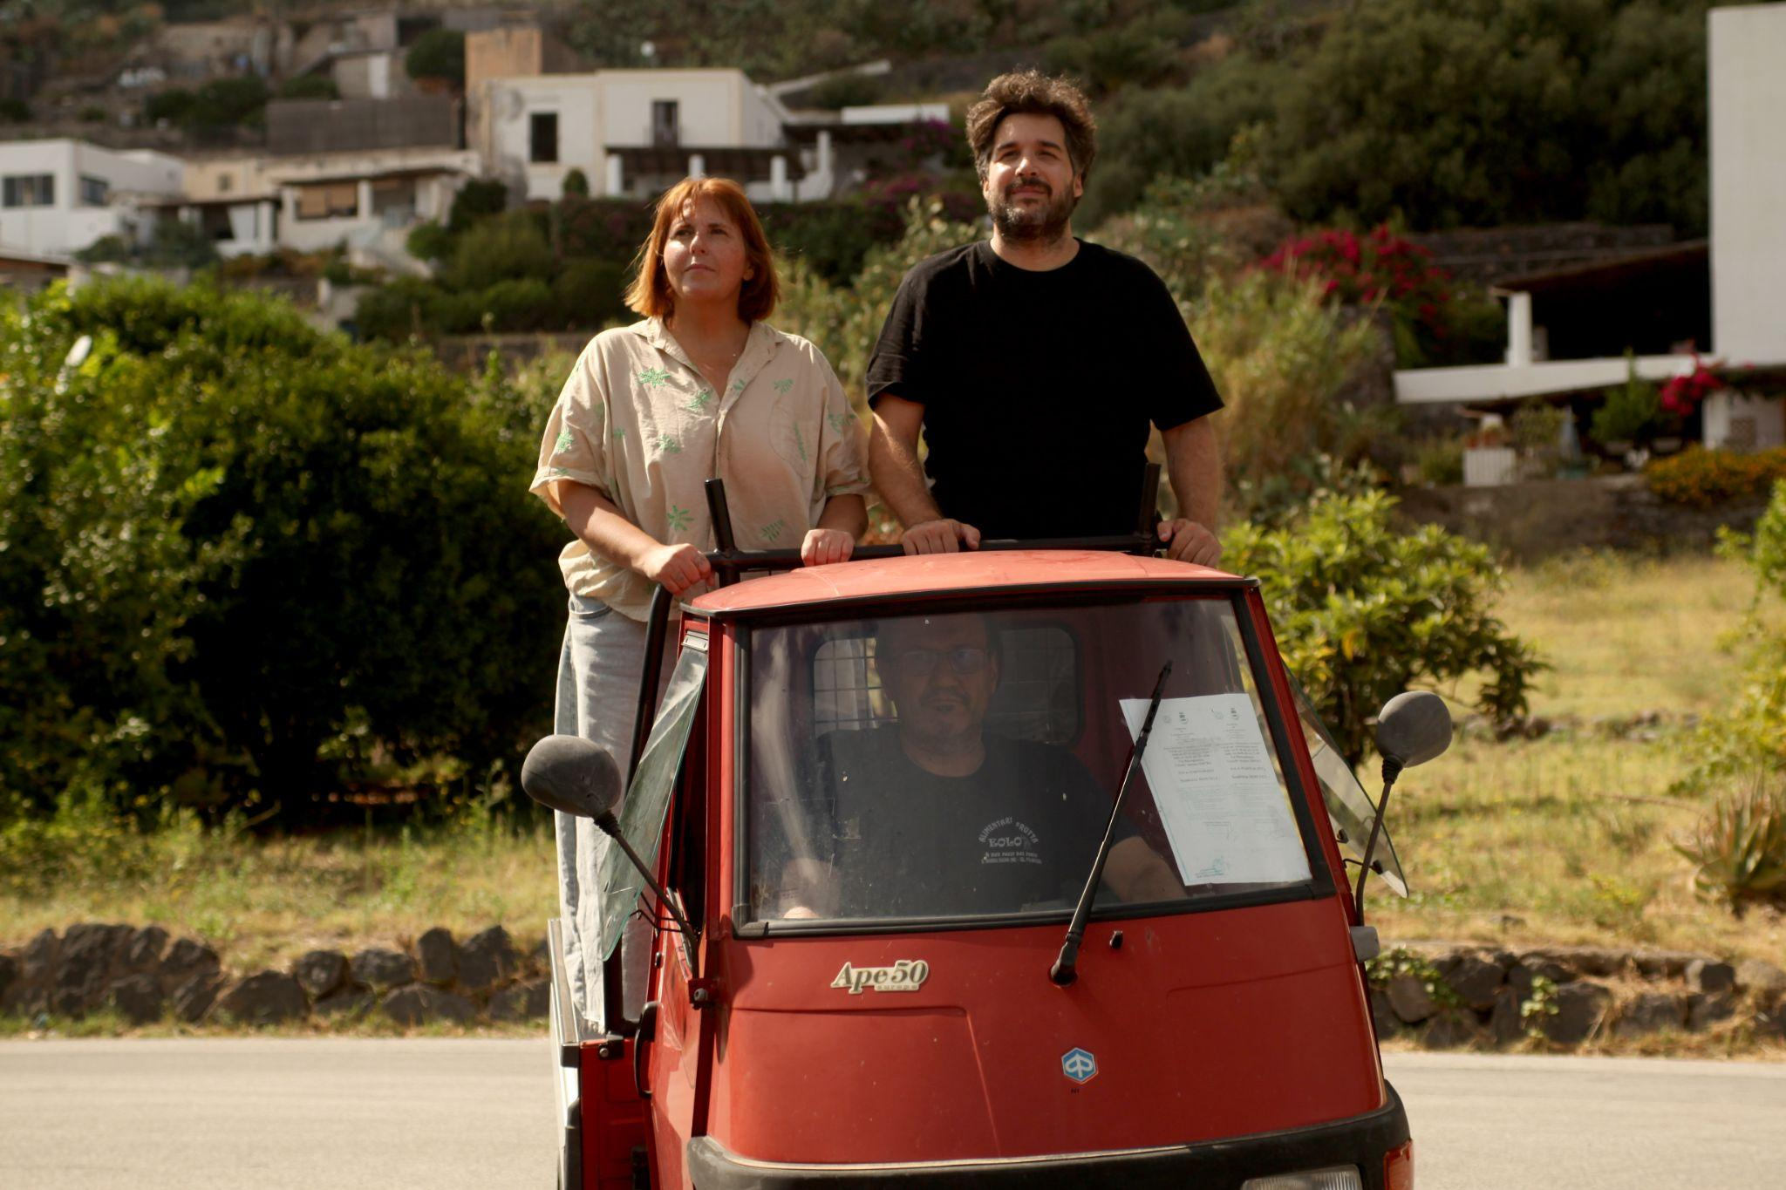
SYNOPSIS.
Which film would you choose to live in?
Have you ever wondered which film you would choose to live in if you had the chance? Spanish filmmaker Pablo Maqueda has no doubts: the sun-drenched Italy of 1993 portrayed in Nanni Moretti’s Caro Diario. Caro Nanni is a road movie through the films that changed our lives, inviting audiences to join the journey and reflect, with humour and irony, on our own transformation.

Slide 7
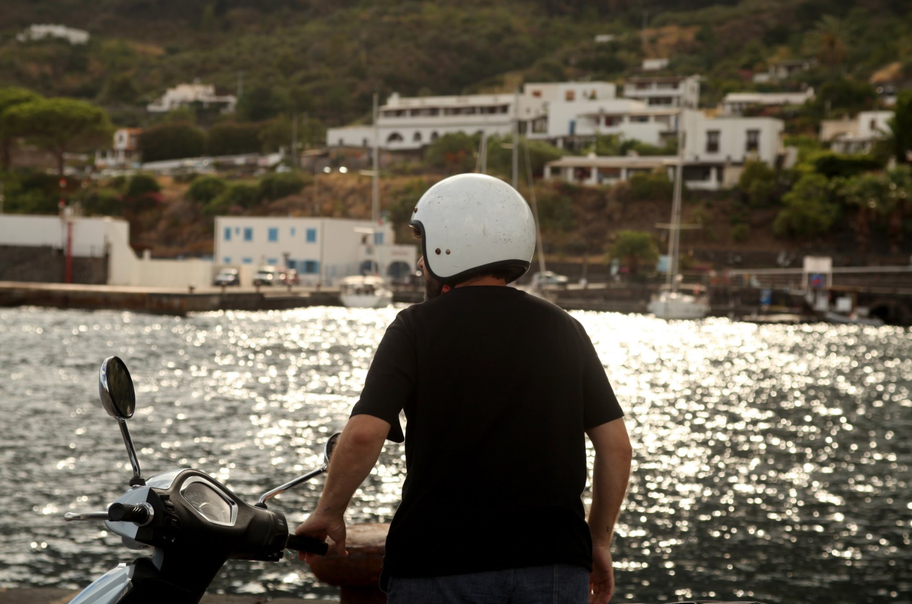
LONG SYNOPSIS.
Which film would you choose to live in?
Pablo Maqueda knows exactly where he would choose: the sun-drenched Italy of 1993 in Caro Diario, Nanni Moretti’s film in which, according to him, life seems to make a little more sense. The problem is that thirty years have passed, Pablo is no longer the same person and, however hard he tries, reality does not look much like a Moretti film either.
So he decides to do the only reasonable thing: escape reality and travel by motorbike to the Aeolian Islands to reconnect with his favourite film. And, like any self-respecting existential crisis, it is better shared with friends. He convinces his film crew to join him on a road movie from Madrid to Italy, following in the footsteps of Caro Diario while also travelling through his own films, memories, obsessions and contradictions.
Thirty years after the release of Caro Diario, this journey becomes an adventure as cinephile as it is absurd, where cinema and life begin to blur into one another. Because films may not be able to save us from reality, but they can help us see it differently. Or, at the very least, laugh at it.
Following Dear Werner, Pablo Maqueda once again hits the road to create a documentary that is at once a tribute, a travel diary, a love letter to cinema and a comedy about that strange age when you discover that your favourite films might know more about your life than you do.
Because in the end, just like after a good film, something will have changed. Even if we still do not know exactly what.

Slide 8
DIRECTOR'S NOTE.
Caro Nanni is a personal documentary born out of my deep admiration for Nanni Moretti and my desire to explore the creative process of filmmaking from a first-person perspective. After the cathartic experience of making Dear Werner (Walking on Cinema), I felt the need to continue along this path of filmed letters, reflecting on the role of the filmmaker both as a creator and as a worker. Set between Madrid and Rome, Caro Nanni offers an intimate dialogue between two cities, two cultures and two ways of making films, while paying tribute to the historic bond between Spanish and Italian cinema. Having completed the shoot, we are now entering the crucial post-production stage, where the film will take on its final form and voice. Completing Caro Nanni within the framework of the Venice Film Festival programme would allow us to bring this journey to life with the artistic depth and ambition it deserves.
At the age of twelve, I discovered that I wanted to become a filmmaker. Alfred Hitchcock’s Psycho was to blame. At sixteen, I understood why I wanted to be one. The innocent culprit was Nanni Moretti’s Caro Diario. At thirty-eight, I set out on the road to explore that “why” more deeply, knowing that the journey is always more important than the destination and that the truest answers are rarely the most obvious ones. The experience of making my previous documentary, Dear Werner (Walking on Cinema), was a profoundly cathartic and transformative process, both personally and artistically. From that moment on, I knew that this path of filmed letters had to continue, however difficult it might be. Caro Nanni was born from that inner impulse: a deeply personal project that seeks to offer new perspectives within the Spanish documentary landscape.
Nanni Moretti is a filmmaker who has left an indelible mark on my life. After years of thoroughly researching his work and his figure, I feel that this is the perfect moment to tell this story. Moretti’s cinema is a cornerstone of contemporary filmmaking and has profoundly influenced world cinema and generations of filmmakers, myself included. His humanistic vision and sensitivity behind the camera continue to inspire me, and with Caro Nanni I seek to delve into his creative process from a place of intimate exploration.
I draw inspiration from filmmakers such as Werner Herzog (Cave of Forgotten Dreams) and Jonas Mekas (Diaries, Notebooks, and Sketches), who found ways to speak in the first person through the language of documentary. I also look to broader approaches such as those of Michael Moore (Bowling for Columbine) and Morgan Spurlock (Super Size Me), who expanded the documentary form by incorporating irony, social criticism and self-reflection. In Spain, filmmakers such as Elías León Siminiani (Mapa), José Luis Guerin (Guest) and Mercedes Álvarez (El cielo gira) redefined these codes to create deeply personal reflections on life and creativity.

Slide 9
In 2020, when I created Dear Werner, it was born out of personal failure and an unwavering desire to make films. The unexpected warmth of audiences and critics, together with the incredible discovery that Werner Herzog himself would join the project as narrator, confirmed for me that this honest and vulnerable approach could truly resonate.
Caro Nanni now represents an evolution of that journey: a playful and open-ended reflection on the filmmaker’s condition as a worker and on the creative process itself, conceived as a work in progress in which the audience becomes part of the narrative creation.
Madrid, my hometown, once again plays an essential role. Its everyday reality, full of life and contradictions, acts as both a counterpoint and a companion to Moretti’s Rome of 1993, creating a dialogue between different times, spaces and ways of inhabiting cinema.
At the heart of Caro Nanni also lies the profound bond between Italian and Spanish cinema. This journey between Rome and Madrid pays tribute to that ongoing dialogue: from De Sica to Berlanga, from Antonioni to Saura, from Fellini to Almodóvar. Madrid, with its vibrant cultural life and its magic, becomes the perfect setting for this story.
Pablo.

Slide 10
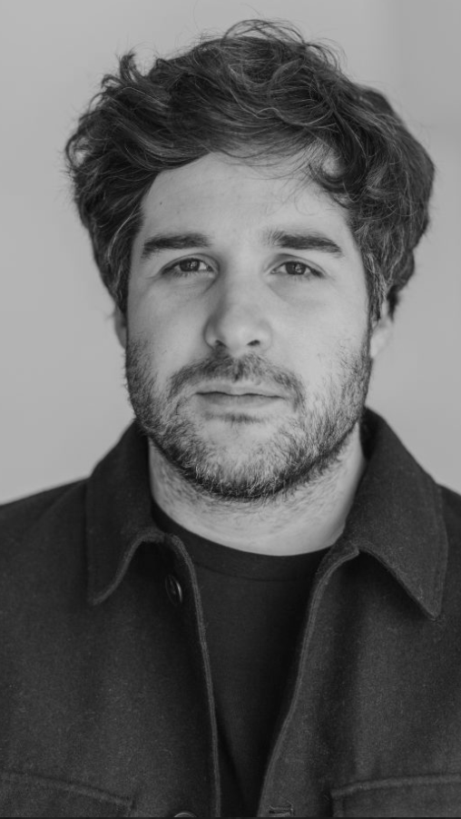
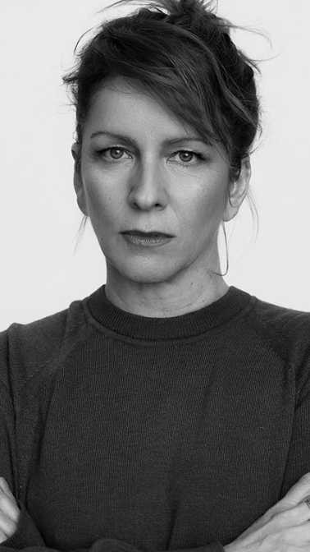
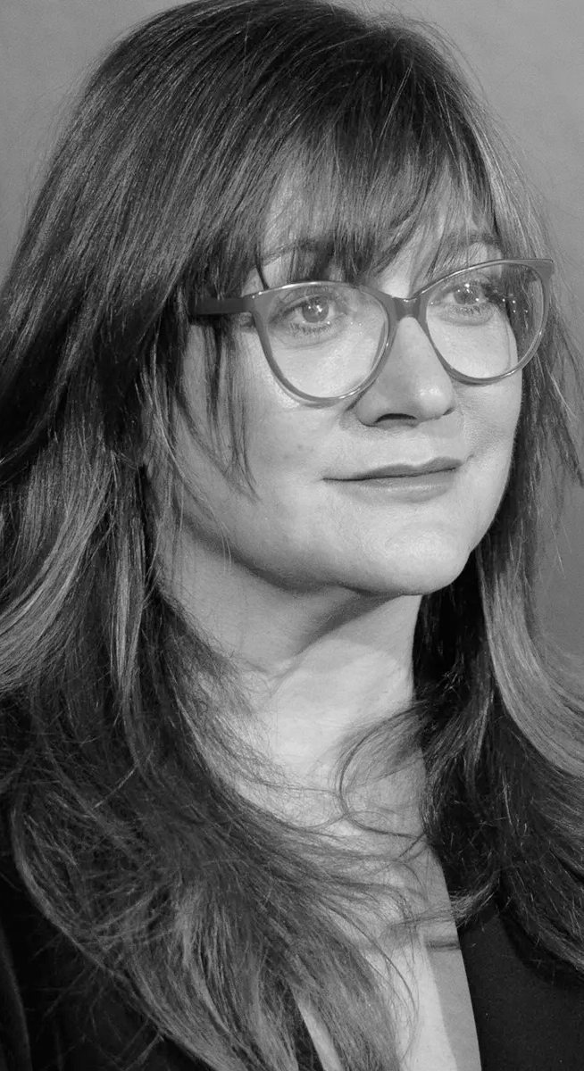
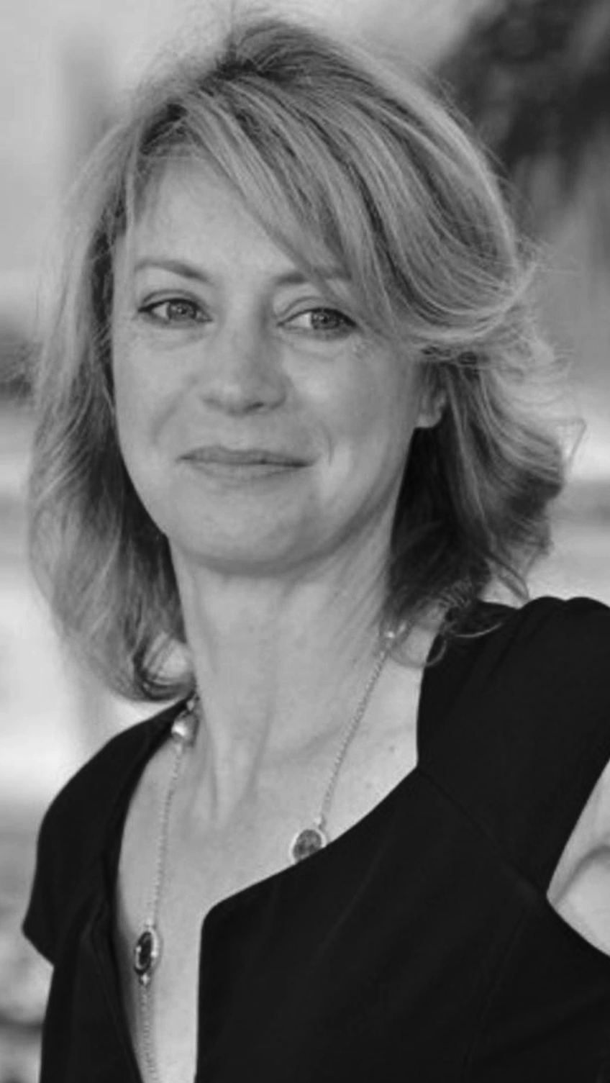
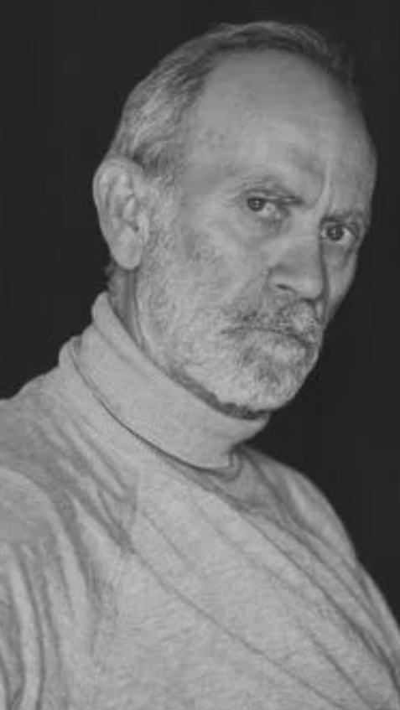
CAST.
Pablo Maqueda
Eva Llorach
Isabel Coixet
Margherita Buy
Vicente León
as
Pier Paolo Pasolini

Slide 11
PRODUCTION NOTES.
Eric Rohmer once said, “We were a group of friends making films on a beach,” and that is the spirit behind this luminous road trip—one that makes you fall in love not only with Moretti and Italy, but also with the joy of creating together.
The first time Pablo hit the road, he did it on foot. Caro Nanni is the second instalment in a trilogy of letters to the filmmakers who have shaped who we are, following Dear Werner, the acclaimed documentary we made in collaboration with Werner Herzog. Without Herzog, Pablo might be a less courageous filmmaker, or perhaps he would never have learned to enjoy the journey instead of obsessing over the destination. Without Moretti, he might never have learned to take himself a little less seriously.
But why make this film? Dear Werner was about frustration, failure, walking on ice in order not to give up, and pursuing the dream of making films. But what happens when you achieve that dream and, standing on the red carpet at an international festival in Busan, South Korea, you suddenly realise that perhaps the destination you had always dreamed of is not really for you? And in that moment of doubt on the red carpet, what were we thinking about? We were thinking about Nanni, dancing on his Vespa, wandering aimlessly through Italy.
We have all felt lost at some point. And so we set out on the road, following Moretti’s filmography and using humour and irony to explore the changes we have experienced as a society since the release of Caro Diario in 1993.
We made this journey surrounded by a crew of friends and by major figures from Moretti’s cinematic world, including Margherita Buy, Isabel Coixet and Valia Santella, among others.
Have you ever wondered which film you would choose to live in if you had the chance?
We would choose the sun-drenched Italy of 1993 in Nanni Moretti’s Caro Diario. A film in which Nanni travels across Italy on his Vespa, sharing his reflections on the society of his time. The society of 1993 is not the society of 2023. Have we changed for the better? It is this spirit of searching that sends us back out onto the road.

Slide 12
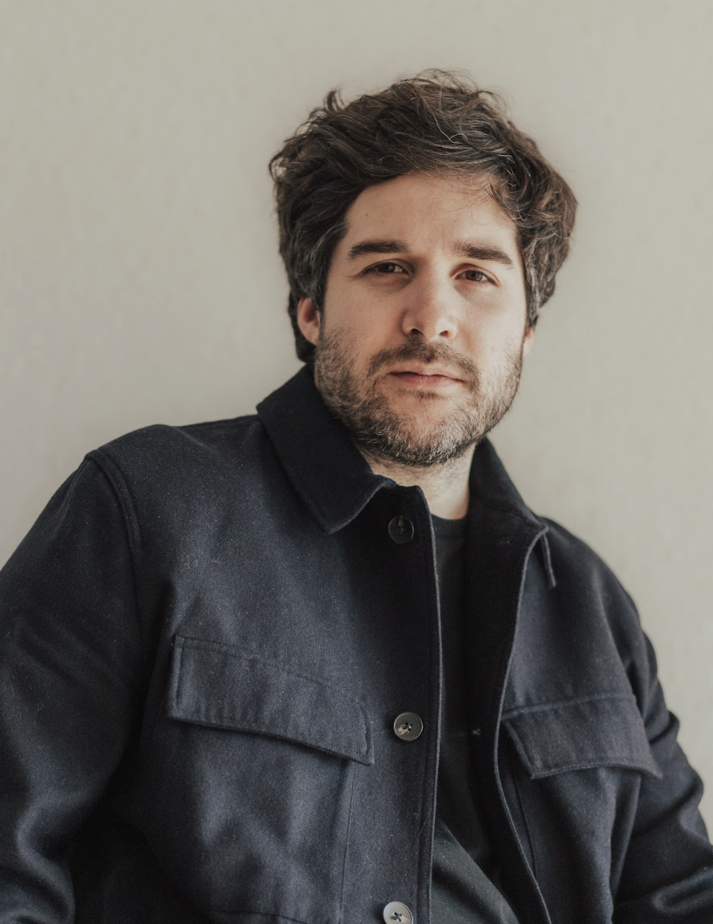
PABLO MAQUEDA, CO WRITER AND DIRECTOR.
After writing and directing several independent projects screened at festivals such as IndieLisboa and the Sitges International Film Festival (All the Women, Manic Pixie Dream Girl, #RealMovie), in 2020 he released the documentary Dear Werner (Walking on Cinema) in cinemas. The film was nominated for a Feroz Award and was singled out by critics as one of the best films of the year.
In 2023, he co-wrote and directed his first fiction feature, La desconocida (Girl Unknown), an adaptation of Paco Bezerra’s play Grooming. The film premiered in the Official Competition at the Málaga Film Festival and screened at the Busan International Film Festival in South Korea, among many other international competitions.
Selected by Variety as one of its 10 Spanish Directors to Track in 2023, and a resident at the Spanish Film Academy in 2024, his latest film, the documentary Caro Nanni, is currently in post-production. Highlighted by Screen Daily as one of the most notable Spanish projects in the works, Caro Nanni is financed by the ICAA, the Community of Madrid, CAM and CREA SGR, with the support of RTVE, Movistar Plus+ and Filmin, and was selected for the MAFIZ WIP section of the 2025 Málaga Film Festival.
He is also developing his next two projects, Penumbra, starring Clara Galle (Through My Window), and Campo di Fiori.
Filmografía
Caro Nanni (2025), co-written and directed by
La desconocida (2023), co-written and directed by
Dear Werner (2020), co-written and directed by
#RealMovie (2013), co-written and directed by
Manic Pixie Dream Girl (2013), co-written and directed by
All the Women (2012), co-written and directed by

Slide 13

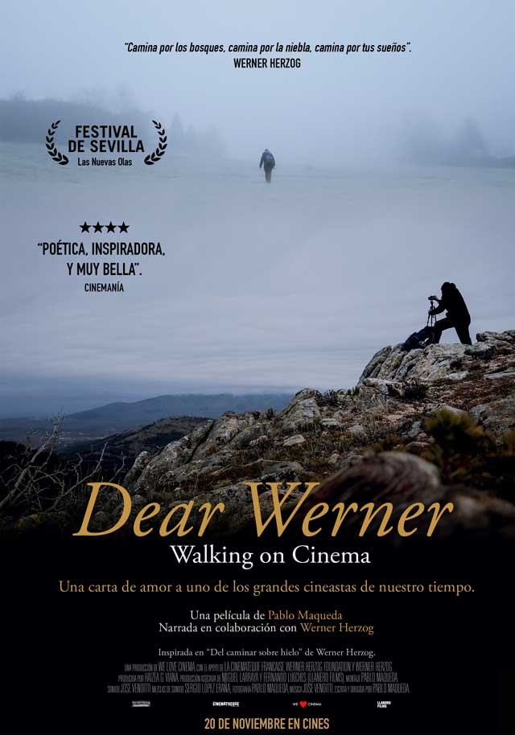
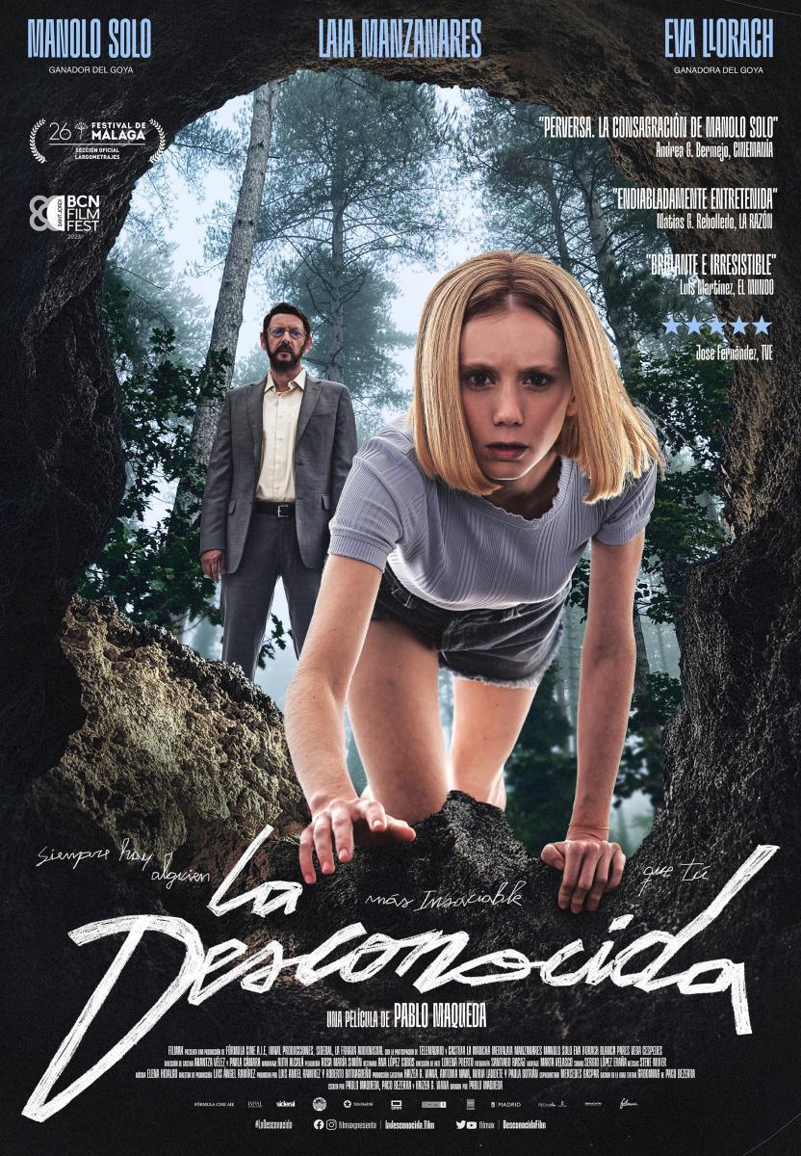

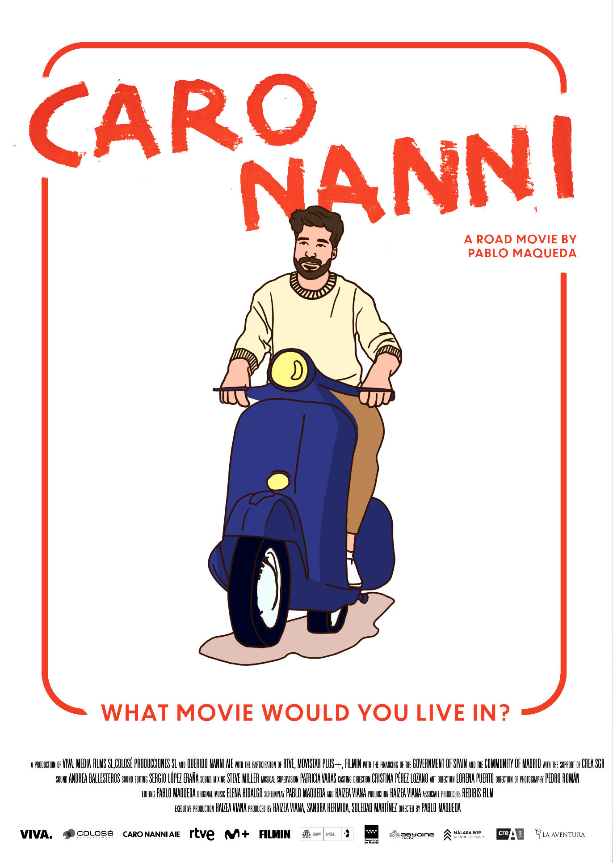
HAIZEA VIANA, CO WRITER AND PRODUCER. VIVA FILMS
With a degree in Audiovisual Communication and a specialisation in film marketing and communications, she has worked for companies including Netflix, Karma Films, Avalon, Golem and Diamond Films. As CEO of VIVA FILMS MEDIA, she has built her career as an independent producer, serving as executive producer on feature films by acclaimed filmmakers including Chema García Ibarra (Uranes), Miguel Larraya (Todo el mundo lo sabe), Marçal Forés (Amor eterno) and Pablo Maqueda (Manic Pixie Dream Girl).
Together with Maqueda, she produced Dear Werner (Walking on Cinema), written and directed by Pablo Maqueda, in collaboration with La Cinémathèque Française and filmmaker Werner Herzog. The documentary had its international premiere in the New Waves section of the Seville European Film Festival and went on to screen at numerous festivals, including Torino, Zinebi, Trento and Chicago. It received the RTVE Días de Cine Award and the Audience Award at the Alcine Film Festival, as well as nominations for Best Documentary at the Feroz Awards and the Cinema Writers Circle Awards, and for Best Spanish Film at the Sant Jordi Awards.
In 2023, she co-wrote the screenplay for La desconocida (Girl Unknown), a thriller directed by Maqueda, on which she also served as executive producer. The film was presented internationally in the Official Section of the Málaga Film Festival and at the Busan International Film Festival in South Korea, among many others.
With the release of La desconocida, she and Maqueda founded VIVA, an independent production company and creative studio where they are developing their upcoming projects: the documentary Caro Nanni and the feature films Penumbra, starring Clara Galle (Through My Window), and Numinosa, starring Milena Smit (Parallel Mothers) and Álex Monner (The Next Skin).

Slide 14
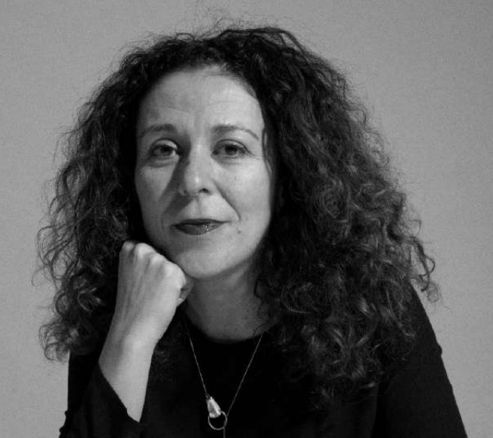
SANDRA HERMIDA, CO PRODUCER. COLOSÉ PRODUCCIONES
Colosé Producciones is a Spanish audiovisual production company founded in 2003 and based in Sant Gregori, Girona. Known for its commitment to high-quality, innovative storytelling, the company has established a strong presence in both the Spanish and international film and television industries. Colosé has produced acclaimed titles such as The Invisible Guest (Contratiempo), Mirage (Durante la tormenta), Garbo: The Spy, Rainbow, and I Hate New York, showcasing its versatility across genres and formats.
A key figure associated with the company is Sandra Hermida Muñiz, an acclaimed Madrid-born producer whose career spans more than thirty feature films, including The Orphanage, The Impossible, A Monster Calls, Biutiful, and the award-winning Society of the Snow.
A multiple Goya Award winner, Hermida is known for her precise, empathetic and impactful approach to production. Her collaborations with renowned filmmakers such as J. A. Bayona and production companies such as Colosé have contributed to strengthening the creative landscape of contemporary Spanish cinema.

Slide 15
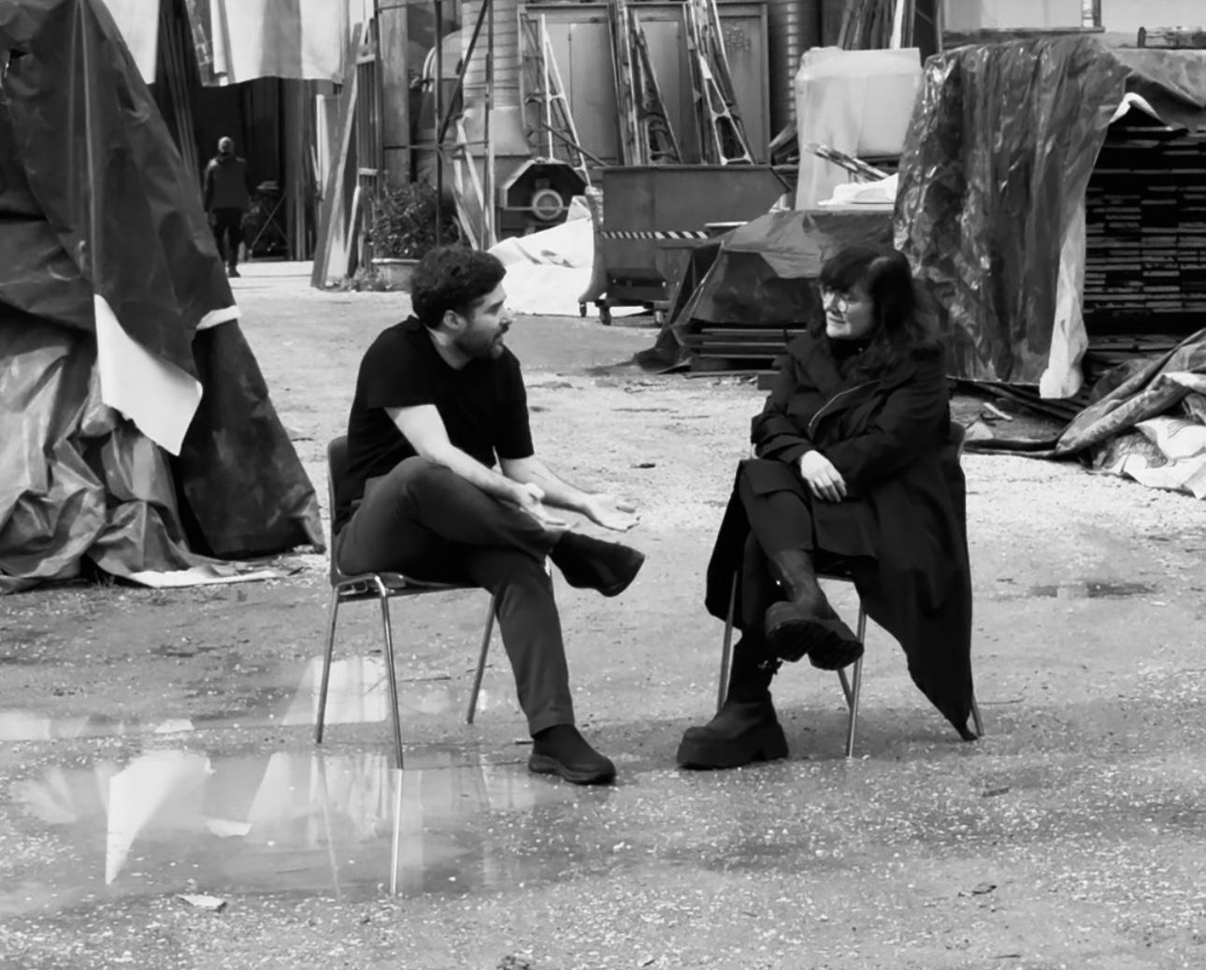
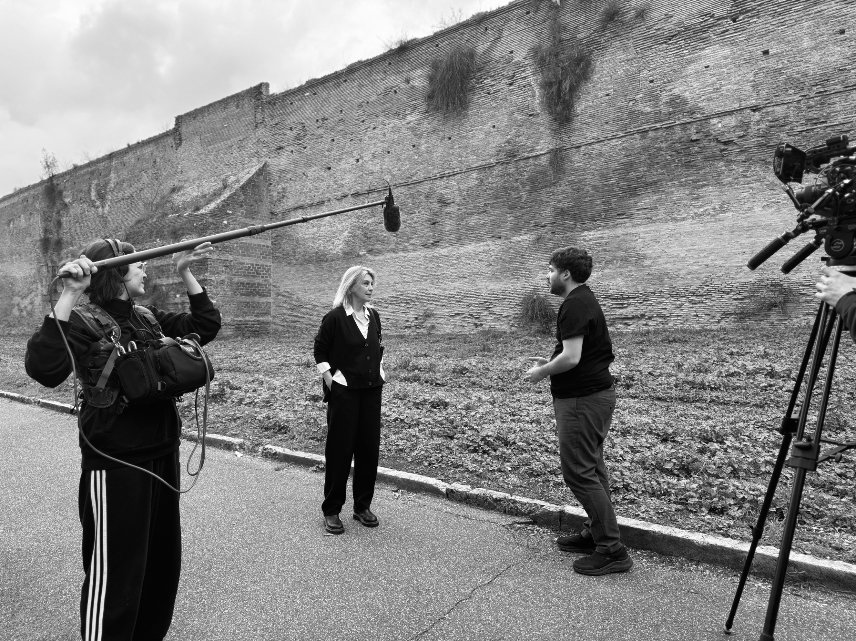
IMAGES.
Pablo in Roma with Isabel Coixet and Margherita Buy.
IMAGES LINK

Slide 16
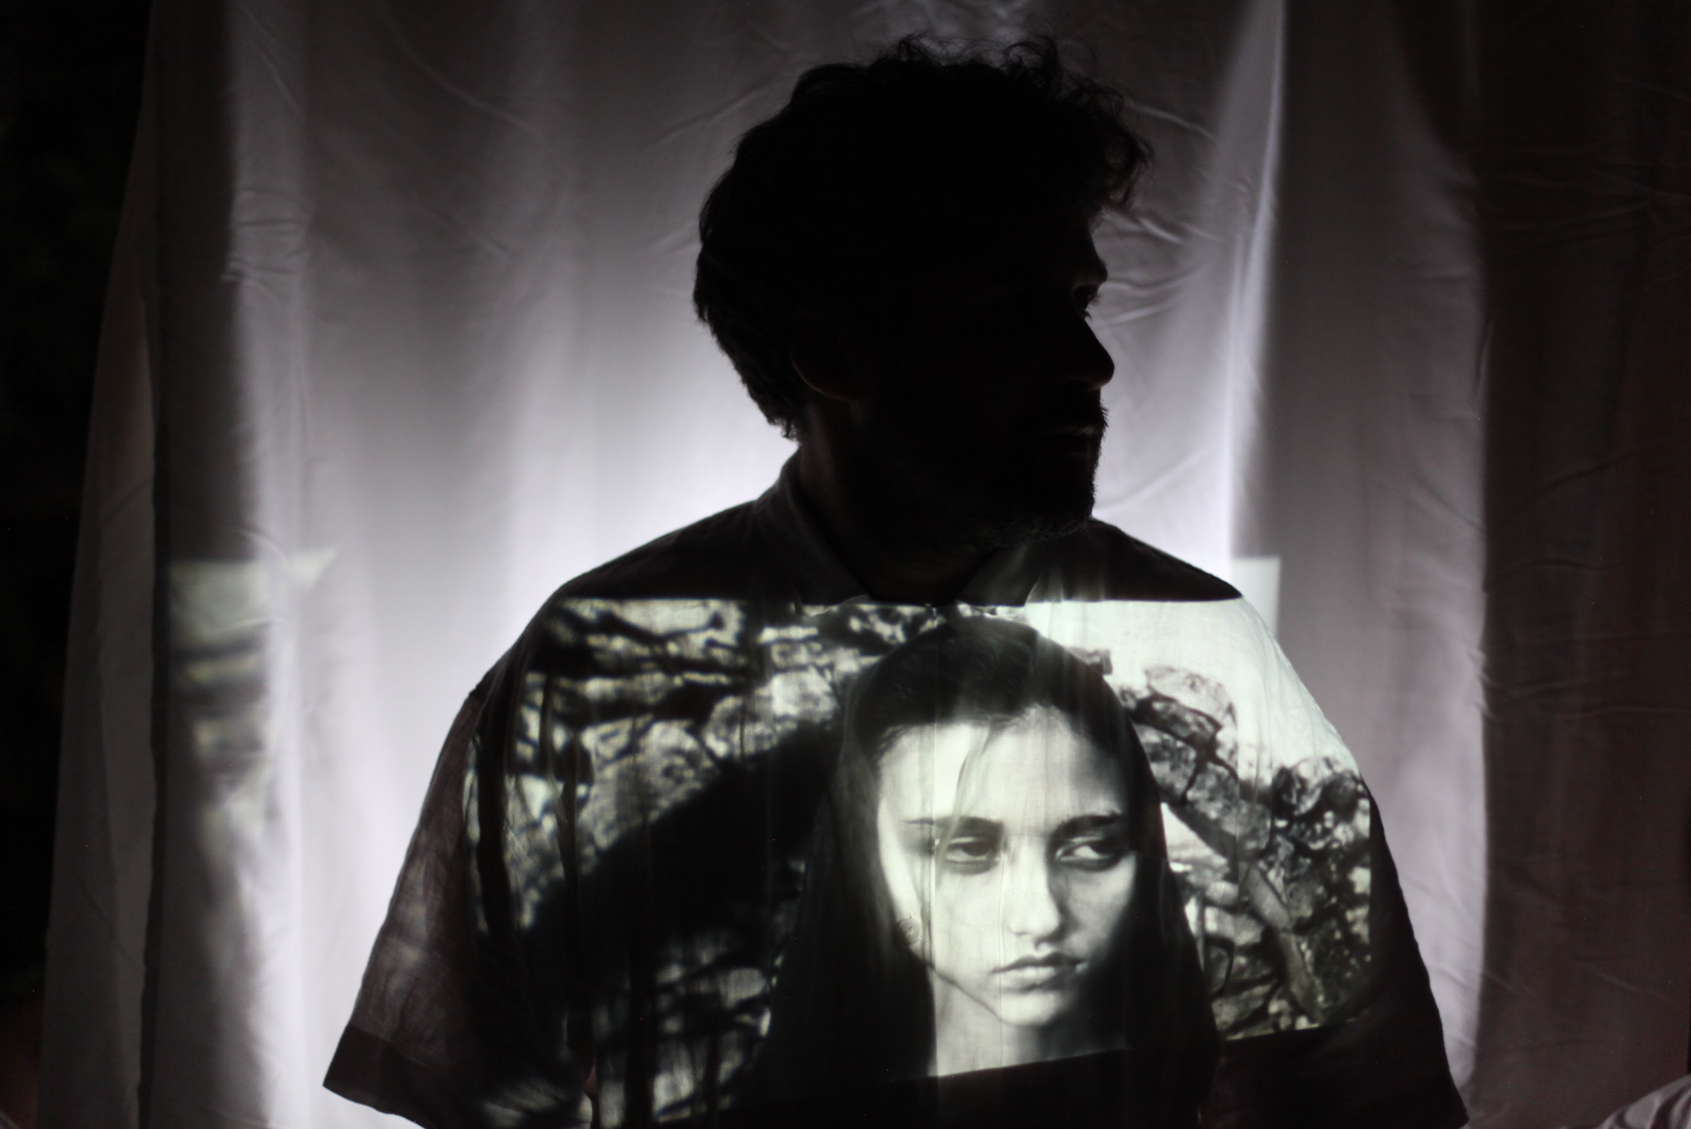


Salina, 2024
Caro Pier Paolo,
Se Nanni Moretti è il regista che è oggi, è anche a causa di quello che è successo su quella spiaggia di Ostia.
Pablo M .

Slide 17

PRESS.
paula@amigossolutions.net

